Slide 1

FORM 2 STEM PROJECT
Chan Tsz Him ( 4 )
Lemuel Ma ( 18 )
Ben Liu ( 17 )
Tam Yu Ji ( 24 )

Slide 2


Slide 3
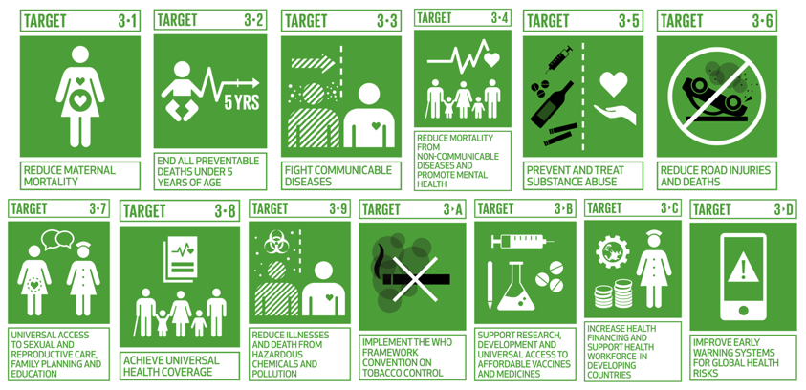

Slide 4

Problem for achieving the SDG
Before: Toxic Chemicals possibly → Death
WHY people cannot identify them

Slide 5



Slide 6
Air Monitoring System
Normal Situation
Keeps on checking the value of the environment
Report data to panel
GAS LEAKAGE
Send unusual data to online panel
Send unusual data to mobile phones connected
Turn on LED lights and emit sound

Slide 7
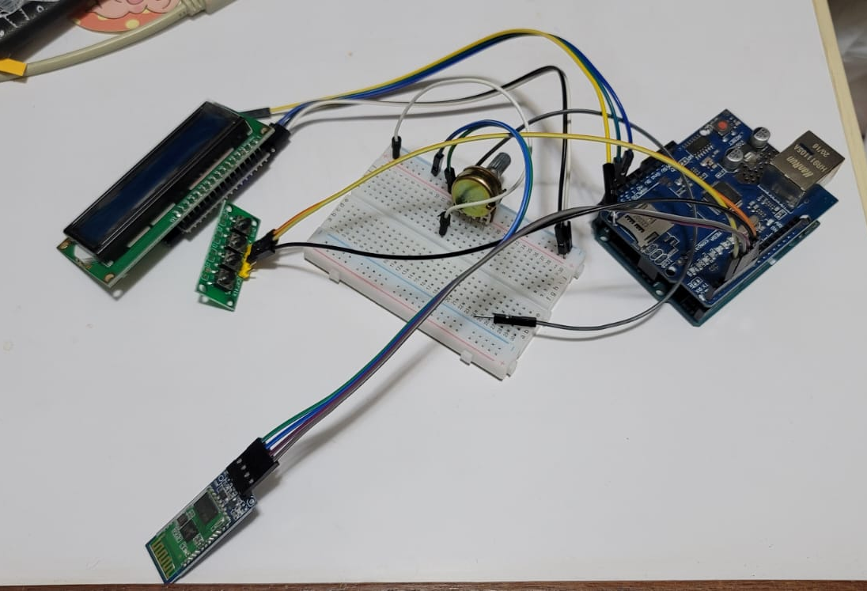
Materials
Char Siu Board
Gas Sensors
Arduino Board
Ethernet Extension Shield
20x4 LCD Display
LED
Buzzer
Battery Holder

Slide 8
Future of the Project
Fume Cupboard
Update the data using the internet wirelessly with ESP32
Test for present of gas in experiment

